Slide 1
TASK-11 INFRASTRUCTURE TESTING AND VALIDATION done by T.Subramanyam.

Slide 2
What is vpc?
A virtual private cloud (VPC) is a virtual network dedicated to your AWS account.
It is logically isolated from other virtual networks in the AWS Cloud.
You can specify an IP address range for the VPC, add subnets, add gateways, and associate security groups.
A subnet is a range of IP addresses in your VPC.
A virtual private cloud (VPC) is a secure, isolated private cloud hosted within a public cloud.
VPC provides networking for your cloud-based resources and services that is global, scalable, and flexible.

Slide 3
What is subnets?
Virtual Private Cloud (VPC) networks are global resources.
Each VPC network consists of one or more IP address ranges called subnets.
Subnets are regional resources, and have IP address ranges associated with them.
In Google Cloud, the terms subnet and subnetwork are synonymous.
VPC (Virtual Private Cloud): A logically isolated section of the cloud where you can launch resources in a virtual network that you define.
Subnet: A range of IP addresses within the VPC. Subnets divide the VPC into smaller networks, each of which can be associated with different security groups and network ACLs.
Public Subnet: A subnet that has a route to an internet gateway, allowing resources in the subnet to be accessible from the internet.
Private Subnet: A subnet that does not have a route to an internet gateway, meaning resources in the subnet are not accessible from the internet.

Slide 4
What is routetables?
A route table in a Virtual Private Cloud (VPC) is a set of rules (routes) used to determine how traffic is directed within the VPC or between the VPC and external networks. It essentially controls the routing of network traffic for all resources in your VPC, including instances, subnets, and gateways.
Key Points About Route Tables in a VPC:
Routing Traffic:
A route table contains routes that specify how traffic is directed. Each route consists of a destination CIDR block and a target. The destination defines the network (such as a subnet or the internet), and the target is where the traffic should be sent (e.g., an Internet Gateway, NAT Gateway, or another subnet).
Default Route Table:
When you create a VPC, a default route table is automatically created for you. This default route table is associated with all subnets in the VPC, unless you specify a different route table for specific subnets. You can modify this default table or create new route tables.
Custom Route Tables:
You can create custom route tables for different subnets in your VPC. For instance, you might want one route table for public subnets and another for private subnets, each with different routing rules. This allows for better control over how traffic is routed.

Slide 5
Routing Entries:
Each route in the table has two parts:
Destination: This specifies the IP address range (CIDR block) for the traffic.
Target: This specifies where the traffic should be directed. Common targets include:
Internet Gateway (IGW): Used for outbound traffic to the internet (usually for public subnets).
Virtual Private Gateway (VGW): Used for routing traffic to a VPN connection.
NAT Gateway/Instance: Used for outbound traffic from private subnets to the internet.
Peering Connection: Used for traffic between peered VPCs.
Local: This is the default route for communication between subnets within the same VPC.
Private and Public Subnet Routing:
Public Subnet Route Table: This will typically have a route that directs internet-bound traffic (0.0.0.0/0) to the Internet Gateway (IGW).
Private Subnet Route Table: This might route internet-bound traffic to a NAT Gateway/Instance in a public subnet (if you need to allow private instances to reach the internet but not be directly accessible from it).

Slide 6
What is internet gateway?
An Internet Gateway (IGW) in a Virtual Private Cloud (VPC) is a component that enables communication between instances in your VPC and the internet.
It acts as a bridge, allowing traffic to flow from your VPC resources (such as EC2 instances) to the internet.
Key Points About an Internet Gateway:
Outbound Internet Access:
When you attach an Internet Gateway to your VPC, it allows instances in public subnets (those with public IP addresses) to send requests to the internet. For example, instances can reach websites, download software updates, or access external APIs.
Inbound Internet Access:
The Internet Gateway also enables external users or systems to access instances in the public subnet (if the instances have public IPs or Elastic IPs and appropriate security group and network ACL settings).
One-to-One Mapping of Public IPs:
Each instance in a public subnet that needs internet access must be assigned a public IP address (or Elastic IP). The Internet Gateway facilitates the communication between those public IPs and the internet.

Slide 7
Route Tables:
In order for the traffic to flow properly, you need to configure the route table of your public subnets.
Typically, you'd add a route that directs traffic destined for the internet (0.0.0.0/0) to the Internet Gateway.

Slide 8
Introduction to Terraform​
​
Terraform is an open-source infrastructure as code (IaC) tool developed by HashiCorp.​
It enables you to define and provision infrastructure in a declarative configuration language called HCL (HashiCorp Configuration Language). ​
With Terraform, you can manage resources across multiple cloud providers, such as AWS, Azure, Google Cloud, and even on-premises data centers. ​
It allows you to define your infrastructure, automate its provisioning, and manage it in a consistent and repeatable way.​
​
​
Key Concepts​
Infrastructure as Code (IaC): Terraform allows you to describe your infrastructure using code. This means that your infrastructure can be versioned, stored in source control, and treated like any other software project.​
Declarative Syntax: Terraform uses a declarative approach to define infrastructure. You describe what you want, and Terraform determines how to create and manage the infrastructure for you.​

Slide 9
State Management: Terraform keeps track of the infrastructure it manages using a state file, typically stored in a local or remote backend. This file represents the "current" state of your infrastructure, which Terraform uses to compare against the desired state defined in your configuration files.​
Execution Plan: When you run Terraform, it creates an execution plan that shows you what actions it will take (e.g., creating, updating, or deleting resources). This plan is shown to you before any changes are made, ensuring transparency and safety in changes.​
Providers: Terraform uses providers to interact with APIs of various services (e.g., AWS, Azure, Google Cloud, etc.). Each provider is responsible for managing resources within its own cloud ecosystem.​
Resources: A resource is a component of your infrastructure, such as an EC2 instance, an vpc or a security group. Terraform uses the resource type and configuration to define these components in your infrastructure.​
Modules: Modules are reusable collections of Terraform configuration files that can be used to simplify complex infrastructure setups. They allow you to create more maintainable and modular infrastructure code.​

Slide 10
How does Terraform work?​
Terraform creates and manages resources on cloud platforms and other services through their application programming interfaces (APIs). Providers enable Terraform to work with virtually any platform or service with an accessible API.​

Slide 11
Terraform configuration set up with Vpcs,Subnets,Route Tables,Internet gateway.
Step 1 :
1.create a folder connect with visual studio code.
2. In a folder we can create a provider.tf file.
3.In the visual studio code
The provided Terraform code creates a complete infrastructure on AWS that includes a VPC,subnets,route tables,internet gateway. Here's a detailed step-by-step explanation of what each section of the code does:

Slide 12
provider.tf
This file defines the required provider for AWS and configures the AWS provider.
terraform {
required_providers {
aws = {
source = "hashicorp/aws"
version = "~> 5.0"
}
}
}
# Configure the AWS Provider
provider "aws" {
region = "eu-central-1"
}

Slide 13
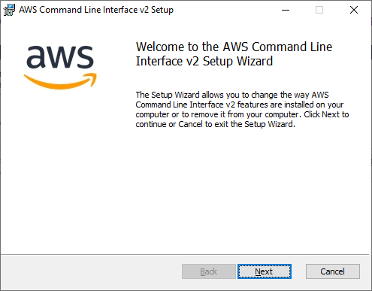
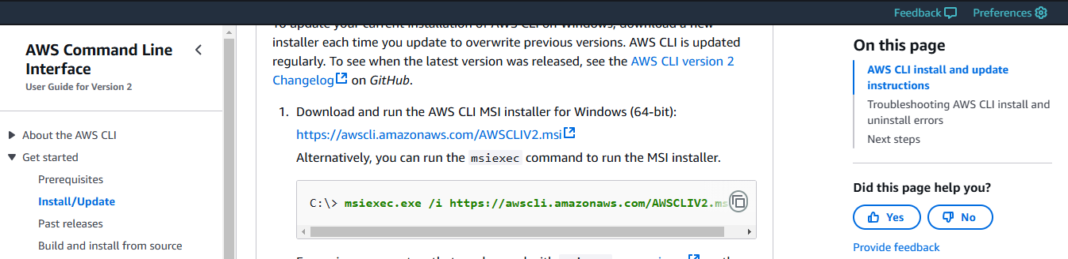
Download and Install AWS-CLI to Configure Access Key and Secret Key.
AWS CLI – Command Line Interface
AWS CLI concepts provides instructions on using the various features of the latest version of the AWS CLI. Version 2 contains all the latest and adds new features.
The AWS Command Line Interface is a unified tool that provides a consistent interface for interacting with all parts of AWS.

Slide 14
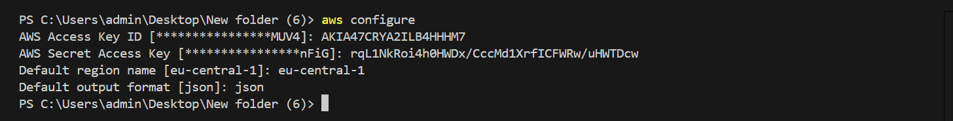
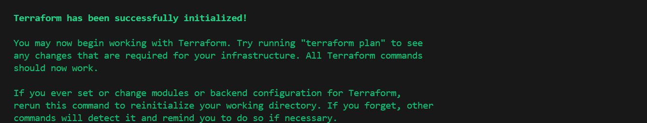
Terraform Block: Specifies the version and source of the AWS provider, in this case, version 5.0 of the AWS provider (hashicorp/aws).
Provider Block: Configures the AWS provider to use the region eu-central-1 (Frankfurt). This is where all resources will be provisioned.
After run below commands in visual studio code
Step 2: aws configure
Step 3 : terraform init
The terraform init command initializes a working directory for use with Terraform

Slide 15
main.tf
This file contains the main configuration, which includes the creation of a VPC, subnets, internet gateway, route tables, security groups, EC2 instance, S3 bucket, RDS instance, and EBS volume.
Vpc code:
resource "aws_vpc" "main" {
cidr_block = "10.0.0.0/16"
enable_dns_support = true
enable_dns_hostnames = true
tags = {
Name = "main-vpc"
}
}
Code explanation:
VPC: Creates a Virtual Private Cloud (VPC) with a CIDR block 10.0.0.0/16, which allows you to create up to 65,536 private IP addresses.
DNS Support: Enables DNS resolution and DNS hostnames within the VPC to simplify the management of instances.

Slide 16
Subnet Setup code:
resource "aws_subnet" "subnet_a" {
vpc_id = aws_vpc.main.id
cidr_block = "10.0.1.0/24"
availability_zone = "eu-central-1a"
map_public_ip_on_launch = true
tags = {
Name = "subnet-a"
}
}
resource "aws_subnet" "subnet_b" {
vpc_id = aws_vpc.main.id
cidr_block = "10.0.2.0/24"
availability_zone = "eu-central-1b"
map_public_ip_on_launch = true
tags = {
Name = "subnet-b"
}
}

Slide 17
Subnets: Two subnets are created:
Subnet A: In Availability Zone eu-central-1a with CIDR block 10.0.1.0/24.
Subnet B: In Availability Zone eu-central-1b with CIDR block 10.0.2.0/24.
Public IP Assignment: Both subnets are configured to automatically assign public IP addresses to instances launched within them.
After add internet gateway code use this:
resource "aws_internet_gateway" "main" {
vpc_id = aws_vpc.main.id
tags = {
Name = "main-igw"
}
}
Code explanation:
Internet Gateway: Creates an internet gateway (main-igw) and attaches it to the VPC. This allows resources within the VPC to communicate with the internet.

Slide 18
resource "aws_route_table" "main" {
vpc_id = aws_vpc.main.id
tags = {
Name = "main-route-table"
}
}
resource "aws_route" "internet_access" {
route_table_id = aws_route_table.main.id
destination_cidr_block = "0.0.0.0/0"
gateway_id = aws_internet_gateway.main.id
}
Route Table: Creates a route table for the VPC and defines a route (0.0.0.0/0) to the internet gateway (main-igw).
Route: This route ensures that any traffic destined for the internet is directed through the internet gateway.

Slide 19
resource "aws_route_table_association" "subnet_a_association" {
subnet_id = aws_subnet.subnet_a.id
route_table_id = aws_route_table.main.id
}
resource "aws_route_table_association" "subnet_b_association" {
subnet_id = aws_subnet.subnet_b.id
route_table_id = aws_route_table.main.id
}
Route Table Associations:
Associates the route table to the subnets, ensuring that instances in these subnets can route traffic to the internet via the internet gateway.

Slide 20
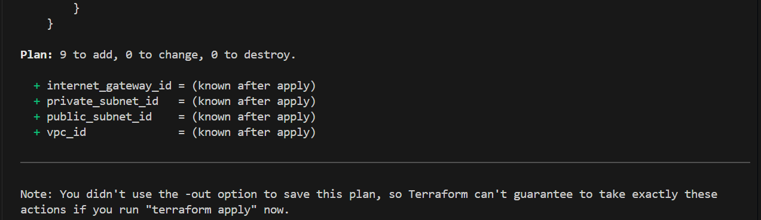
Plan Terraform Execution​
Run terraform plan to:​
Preview the changes Terraform will make to your infrastructure.​
Ensure the configurations are correct before applying changes.​

Slide 21
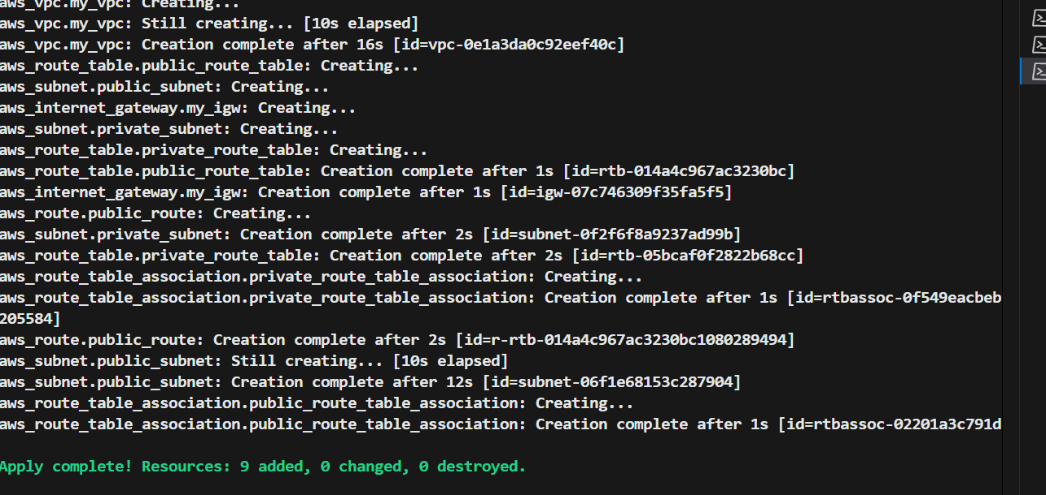
Apply Terraform Configuration​
Execute terraform apply to:​
Provision and configure resources as defined in your Terraform files.​
Review and confirm the changes if prompted.​

Slide 22

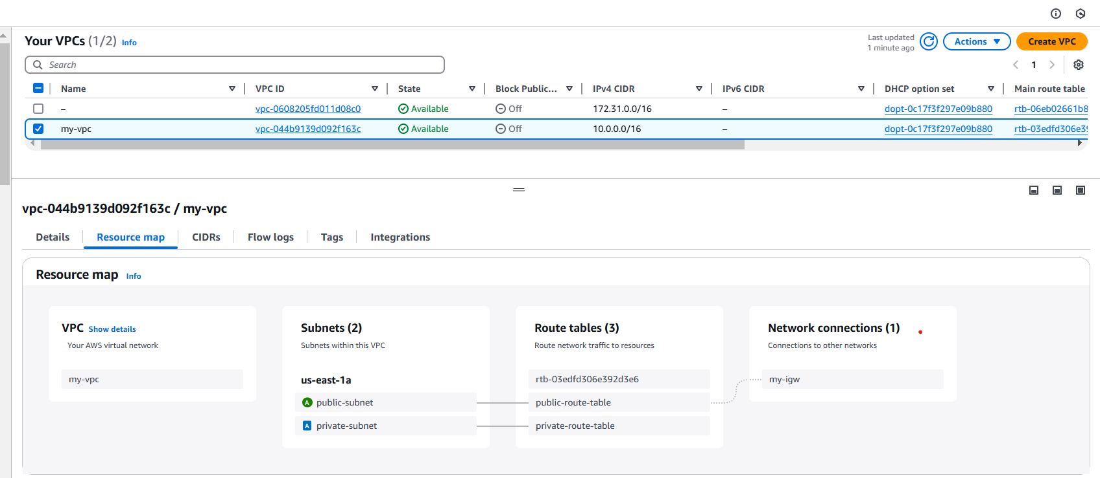
After apply vpcs, subnets,Route tables, internet gateways its shown below:

Slide 23
THANK YOU

